Slide 1
California’s Energy:
Where do we go from here?
Mark Bernstein
RAND

Slide 2
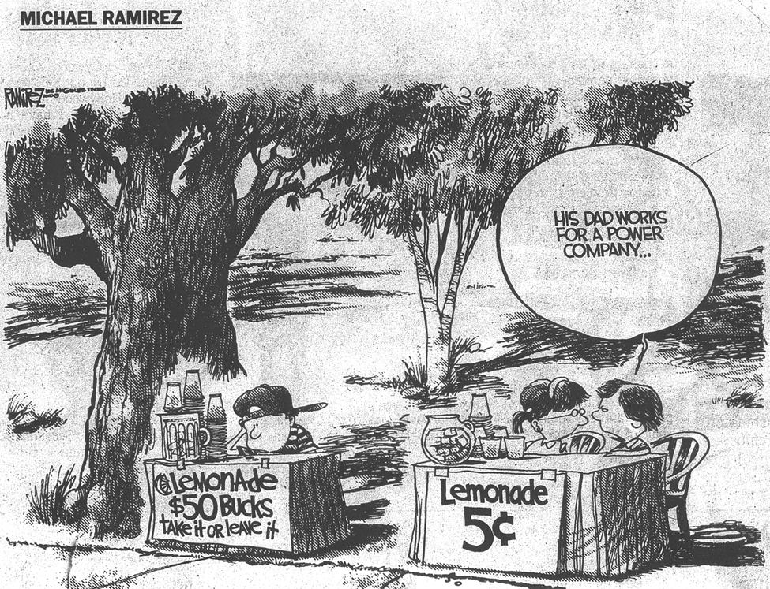

Slide 3


In 1998, RAND Created Two Scenarios,
One Sunny and One Like This
Continued
uncertainty
Weak, if any federal legislation
More states move toward competition
More price fluctuations
Increasing chaos
Market has troubles due to differences between states
Large numbers of retail consumers cause problems
Transmission constraints
Demand increases
Average price reductions
More chaos
Consolidations and bankruptcies
Reliability problems
Higher than expected costs
Prices rise and spike due to severe weather conditions
Chaos
Federal action
Price spikes and volatility
Blackouts
Some states roll-back competition
Higher prices
Less chaos and
less market
Smaller number of generators
Most states move towards consistency
Some market restrictions
Higher than expected costs and prices
Adapted from a presentation given at the Anderson School of Business, UCLA, September 1998

Slide 4
Prices Can Be An Indicator of
Market Behavior
Maximum day-ahead market clearing price
1600
1998
1999
1400
Retail competition
1200
1000
Dollars
per
MWh
800
600
400
200
0
Apr
Jul
Oct
Jan
98
98
98
99

Slide 5
The Effects of Restructuring
Were Not Yet Felt in 1999
Maximum day-ahead market clearing price
1600
1998
1999
1400
1200
1000
Dollars
per
MWh
800
600
400
200
0
Apr
Jul
Oct
Jan
Apr
Jul
Oct
Jan
98
98
98
99
99
99
99
00

Slide 6
Prices Drove the Perception of a “Crisis”
Maximum day-ahead market clearing price
1600
1998
1999
2000
1400
$1,500/MWh
1200
1000
Dollars
per
MWh
$800/MWh
1st FERC soft
price cap
800
600
2nd FERC soft
price cap
400
200
0
Apr
Jul
Oct
Jan
Apr
Jul
Oct
Jan
Apr
Jul
Oct
Jan
98
98
98
99
99
99
99
00
00
00
00
01

Slide 7
By February 2001, State Was in Crisis Mode
Maximum day-ahead market clearing price
1600
1998
1999
2000
2001
1400
1200
1000
Dollars
per
MWh
State begins to buy power; discontinues retail access
800
600
400
200
0
PX closes
Feb 01
Apr
Jul
Oct
Jan
Apr
Jul
Oct
Jan
Apr
Jul
Oct
Jan
98
98
98
99
99
99
99
00
00
00
00
01

Slide 8
Was the Situation Stabilizing by March 2001?
Maximum day-ahead market clearing price
1600
2001
1998
1999
2000
* After January 2001, these are representative border prices
1400
1200
1000
Dollars
per
MWh
800
Efficiency
programs
600
400
200
0
Apr
Jul
Oct
Jan
Apr
Jul
Oct
Jan
Apr
Jul
Oct
Jan
Apr
98
98
98
99
99
99
99
00
00
00
00
01
01

Slide 9
If Prices Drove the Crisis, Then
Is the Crisis Over?
Maximum day-ahead market clearing price
1600
1998
1999
2000
2001
1400
1200
1000
FERC
Order #1
Dollars
per
MWh
800
FERC
Order #2
600
400
200
0
Apr
Jul
Oct
Jan
Apr
Jul
Oct
Jan
Apr
Jul
Oct
Jan
Apr
Jul
Oct
98
98
98
99
99
99
99
00
00
00
00
01
01
01
01

Slide 10
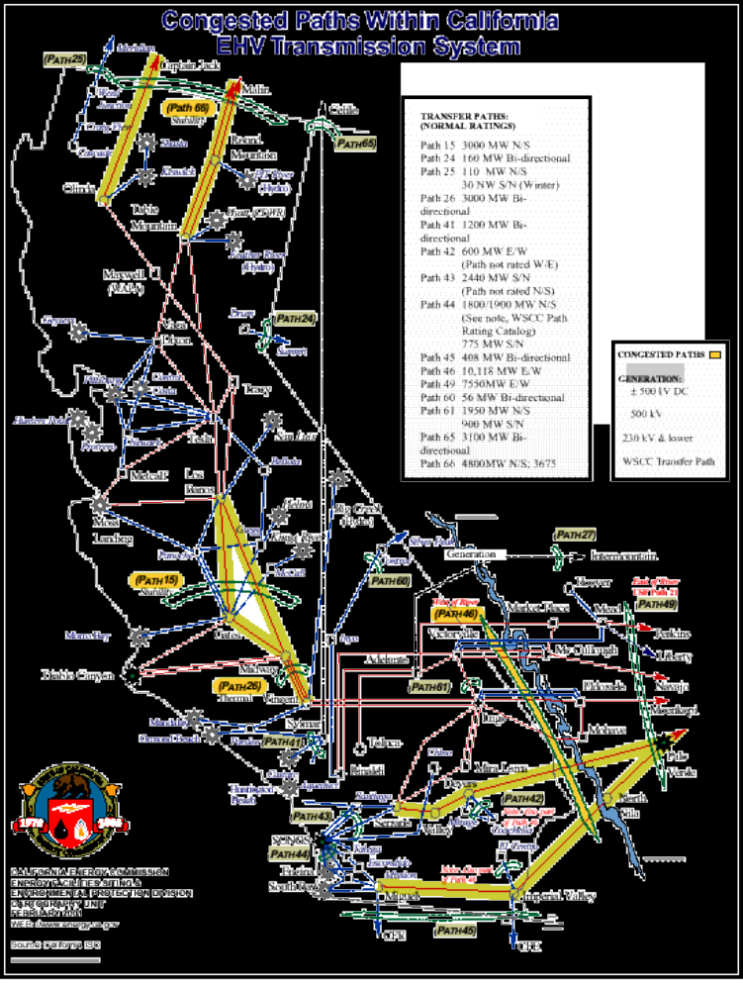
There Are Significant Transmission
Constraints in California
  Geographic location of new plants
  Moving power to where it is needed
  Cost of transmission losses
  Role of new technologies
  Not only a California problem
CEC website: www.energy.ca.gov/maps/transmission_lines.html

Slide 11
Natural Gas Plays A Role
Natural Gas Spot Contract Market Prices
Dollars per million British thermal units
60
50
40
30
20
10
0
Southern California
Dollars
per
MMBtU
Northern California
Henry Hub, LA
10/13 11/10 12/8 1/5 2/2 3/2 3/30 4/27 5/25 6/22 7/20
00 00 00 01 01 01 01 01 01 01 01
Source: enerfax.com

Slide 12
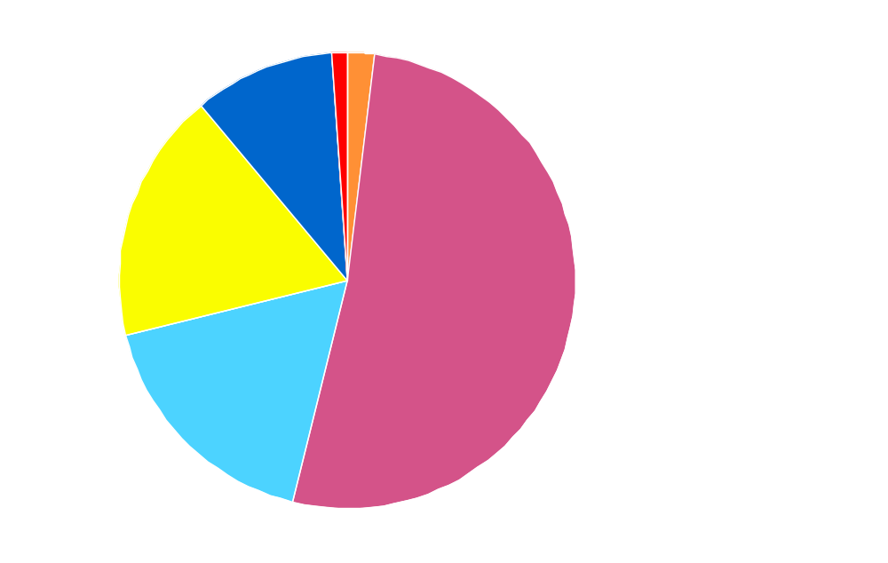
Where Will Gas For New Generation Come From and What Will It Cost?
Other
1%
Other
1%
Coal
2%
  California is adding 5,000 MW of natural gas
  In the West, 8,600 MW of new gas generation is coming on line
  10,000 MW has been approved and 15,000 MW is under review
Coal
2%
Renewables
10%
Renewables
10%
Large hydro
Large hydro
18%
Large hydro
18%
Natural gas
52%
Natural gas
52%
Nuclear
17%
Nuclear
17%
2000
California’s in-state fuel mix

Slide 13
Have Seasonal Consumption Patterns
Changed?
250,000
1998
1999
2000
200,000
150,000
Monthly natural gas consumption
(Million cubic feet)
In 2000 the peak
month for gas
consumption was
August -- different
from past years
100,000
50,000
0
Source: Natural Gas Monthly
Source: EIA, "Natural Gas Monthly," Feb. 2000 and
EIA, "Natural Gas Monthly," Feb. 2001

Slide 14
It Impacts Storage
In 2000 California withdrew
almost as much in the summer
as in the winter
40,000
30,000
Withdrawals from storage
20,000
10,000
Net withdrawals from storage in
California (Million cubic feet)
0
-10,000
-20,000
Injections into storage
-30,000
1998
1999
2000
-40,000
Source: Natural Gas Monthly
Source: EIA, "Natural Gas Monthly," Feb. 2000 and
EIA, "Natural Gas Monthly," Feb. 2001

Slide 15
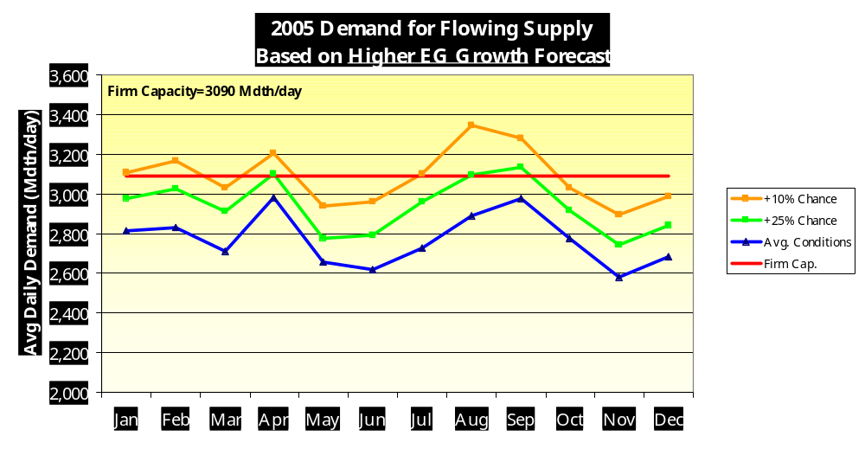
PG&E Expects a 25% Chance of High Demand Risking Price Spikes
CA State Assembly Hearings, March 23, 2001

Slide 16
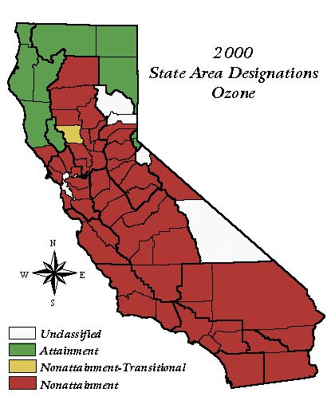
Environmental Issues Will Continue to Play a Role
  Pollution is still a problem
  Natural gas plants don’t necessarily help

Slide 17
Consumers Tend To Be Overlooked
20
18
16
Increase in burden if price doubles
14
12
Energy costs as a percentageof income
10
8
6
4
2
5
15
25
35
45
55
65
75
Household income in $1,000s

Slide 18
Here’s What We Still Need to Know
  Market stability: What are the mechanisms and conditions for creating competition and controlling volatility?
  Restructuring: How will restructured markets work under stress?
  Pricing: What impact will time of use rates and real time pricing have?
  State power authority: What should its role be?
  Demand: How much was efficiency and how much was conservation?

Slide 19
Here’s What We Still Need to Know
  Consumers: Should there be lifeline rates and how much?
  Natural gas supply and price: What do we really know about the gas supply?
  Diversity of supply: What roles do efficiency, renewables, and distributed generation play in balancing the portfolio?
  Environmental outcomes: What effect will regulatory changes and new capacity have on air and water quality?

